Slide 1
Commercial recycling & plastics ban concepts
Marihah Abdullah

Slide 2
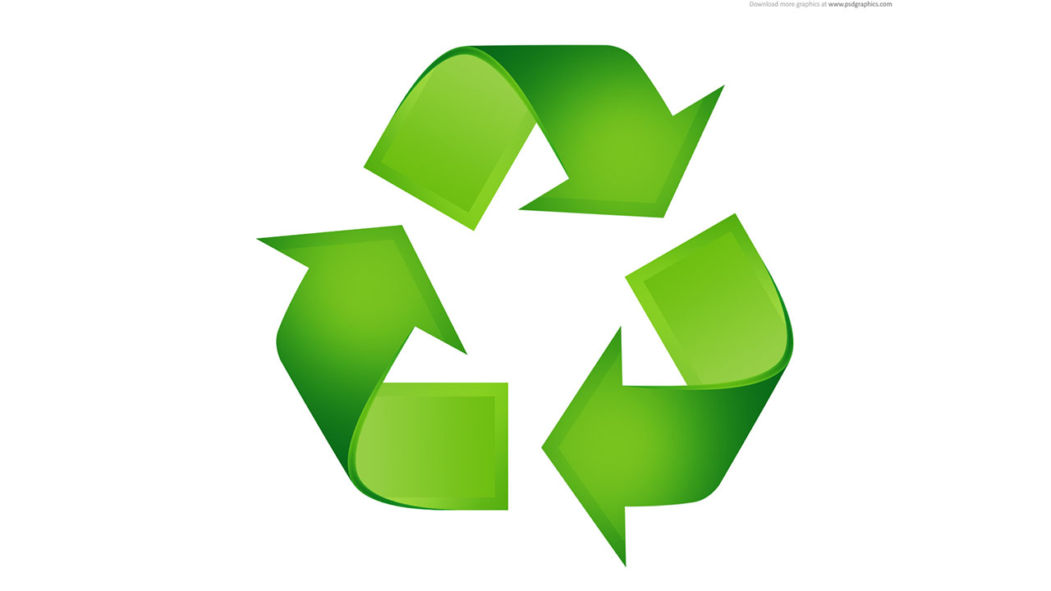
Mandatory commercial & multi-family recycling
Affects businesses and multi-family residential properties (apartment buildings with at least five units), which are then required to recycle
A large step for a city with a goal to be more environmentally-friendly, as such measures ensure that most of the recyclable waste generated are recycled, thus reducing the amount of space it would take up in landfills and reducing greenhouse gas emissions, such as methane, from landfills.

Slide 3
Current mandatory recycling regulations
Several cities mandate businesses and multi-family properties to recycle, but regulations vary by city.
San Carlos, CA
Ordinance implemented in 3 phases over a period of two years
Voluntary participation; main priorities of the city were education and outreach to businesses on the importance of recycling
Required all businesses to “source separate recyclable materials, except for organic materials.”
All businesses were required to separate out organic materials to recycle as well.
Fairfax, VA
Gives businesses great flexibility in creating and implementing their own recycling programs—which then must be reported to city annually (regarding types and amounts of wastes produced and recycled).
Honolulu, HI
Recycling requirements are tailored to each type of businesses to ensure a most effective approach; bars and restaurants are required to recycle glass containers, office buildings are required to recycle paper, and food-related businesses are required to recycle food waste.

Slide 4
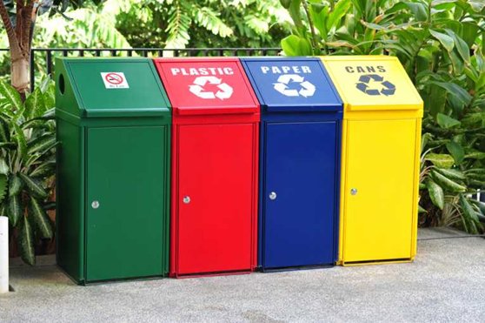
Mandatory recycling recommendation
Implement Mandatory Commercial and Multi-Family Recycling ordinance in two phases to ease the transition of businesses and multi-family properties to the new regulations.
Utilize the Integrated Waste Management approach of Honolulu, HI by tailoring regulations to types of businesses and wastes produced
Utilize the flexibility of Fairfax, VA in allowing businesses to produce their own recycling plans that fit the requirements set by the city

Slide 5
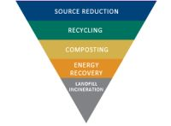
In an ideal world…
Conduct an analyzation of the amount of, and types of, recyclable wastes that each business and multi-family property in Bexley produces in order to determine the best approach to take in reducing the possibility of such wastes ending up in landfills.
Based on this information, establish an Integrated Waste Management style of program in which the way each type of waste is recycled is specifically tailored to what is most logical and environmentally-friendly for that type of waste
For example, require food-related businesses to compost their food waste, require electronics businesses to reuse electronic parts instead of throwing away e-waste, and require offices to recycle paper waste

Slide 6
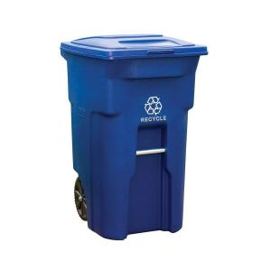
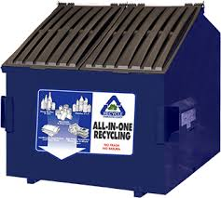
Phase 1
Require that, at a minimum, each business must own a 96-gallon toter bin to collect recycling; Bexley could offer to provide a reduced price for these.
By requiring businesses to own a large recycling bin, the city of Bexley is ensuring that the option of recycling is accessible to, and convenient for, each businesses—thus increasing the likelihood of waste being recycled as opposed to thrown away.
Bexley could propose options for multi-family residential properties to choose from in order to comply with recycling requirements:
Both of these options would ultimately encourage families residing in the property to recycle.
Providing a 48-gallon capacity recycling container per each unit of the property
Provide a 3- cubic yard dumpster to contain recyclable materials generated by all the families housed in the residence.

Slide 7
Phase 2
Much like Fairfax, VA, Bexley could require that all businesses must each create their own recycling plan and have it approved by the city of Bexley to ensure that it is the most sustainable and logical course of action for maximizing the amount of waste that is recycled.
The city of Bexley could make use of the principles of the idea of Integrated Waste Management to approve the plans for each businesses. Once each business has a recycling plan, they must annually report the amount of, types of wastes recycled, and the ways that these different wastes were recycled to the city of Bexley.

Slide 8
Single-use plastics regulations
Plastic Bag Bans
Many cities have banned stores altogether from distributing single-use plastic bags at checkout, including Seattle, WA; San Francisco, CA; Boston, MA; Austin, TX; and Portland, OR.
However, these bans only cover single-use plastic bags; plastic bags meeting thickness requirements to be deemed “reusable” are still allowed.
Plastic Bag Taxes
Various areas have decided to discourage consumers from using plastic bags by requiring stores to impose an added charge of a few cents to consumers if they opt to “buy” a single-use plastic bag, including Washington, DC; England; and, previously, Toronto, CA.
Plastics Regulations
Many other cities and areas have decided to ban other types of single-use plastics—such as straws, utensils, cups, and bottles—including Malibu, CA; Taiwan; and Seattle, WA.

Slide 9
Plastic bag regulation recommendation
Implement a Plastic Bag Tax where consumers are charged an extra 5 cents if they opt to “buy” a single-use plastic bag with their purchase; use the proceeds generated by this fee for various environmental initiatives in Bexley, such as:
Fund the use of “green” alternatives to pesticides and herbicides on public lawn areas
Fund the installation of solar energy on public buildings
Offset the cost of composting food waste from homes and businesses in Bexley

Slide 10
plastic products regulation recommendation
Implement a complete ban on single-use plastic products such as straws, bottles, and utensils over 3 phases:
Encourage businesses—such as cafés, bakeries, and restaurants—to switch to plastic-free alternatives; provide free education and outreach on effective substitutes
Require businesses to implement a tax on plastic products (i.e. if a customer chooses a plastic straw over a free paper straw at a coffee shop, they pay extra)
Establish a complete ban on all single-use plastic products, so that businesses can no longer offer them to consumers

