Slide 1
Bexley Bloomers
Established 2021

Slide 2
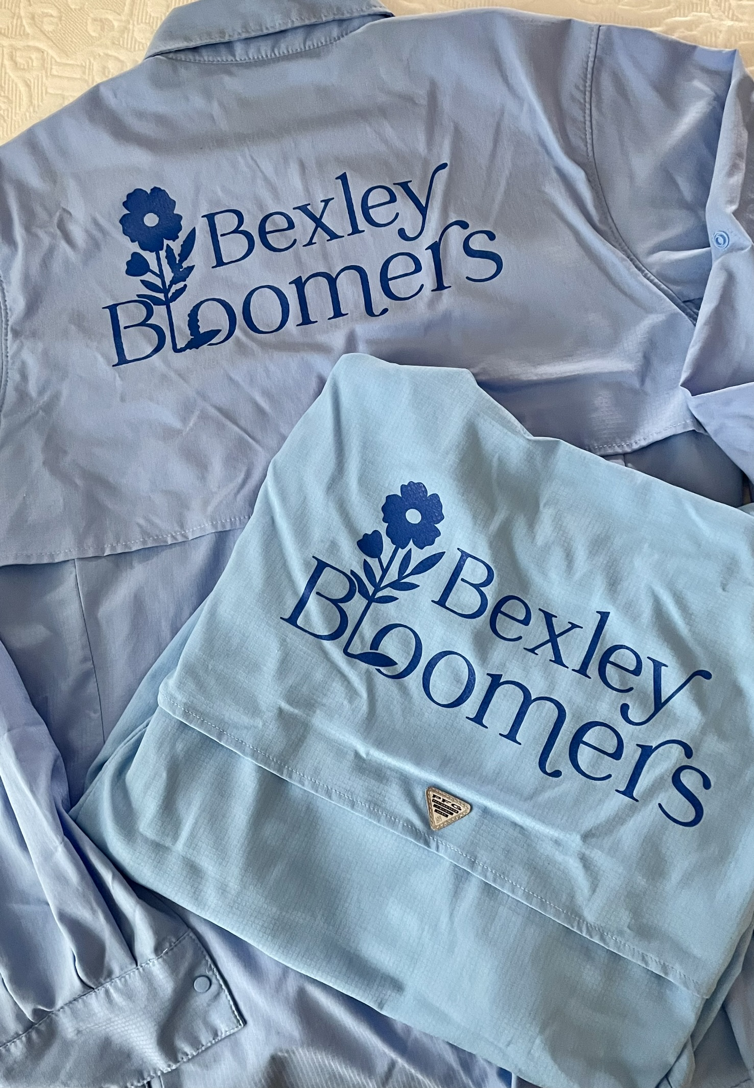
Bexley Bloomers
Who are we?
  Founded in 2021
  2339.75 Total Hours Volunteered
  $71,116 Volunteer Dollar Value / Staffing Dollars Saved for City
  Support from around the city
    St. Charles Students
    City Staff
    Bexley Women’s Club
    Bexley HS Girls Soccer Team and Coaches
    Bexley Community Foundation
What do we do?
  Weed, weed, weed
  Plant and mulch
  Volunteer at the Community Gardens
  Volunteer at city parks
  Have fun!

Slide 3
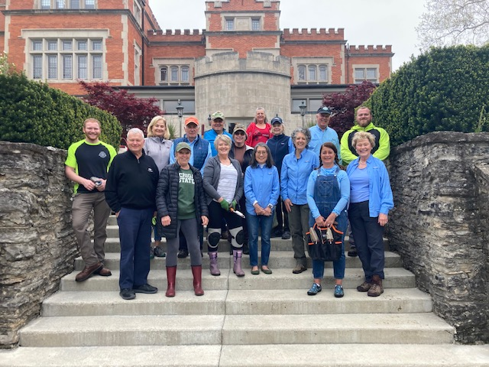
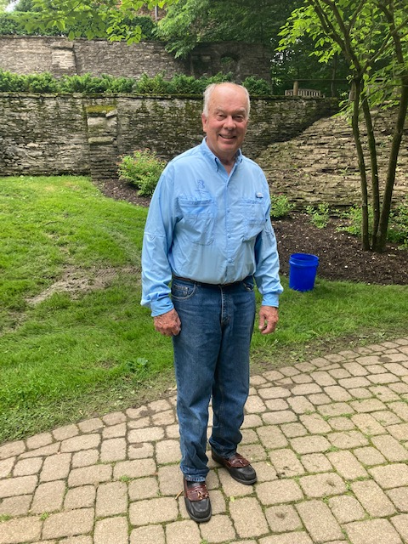
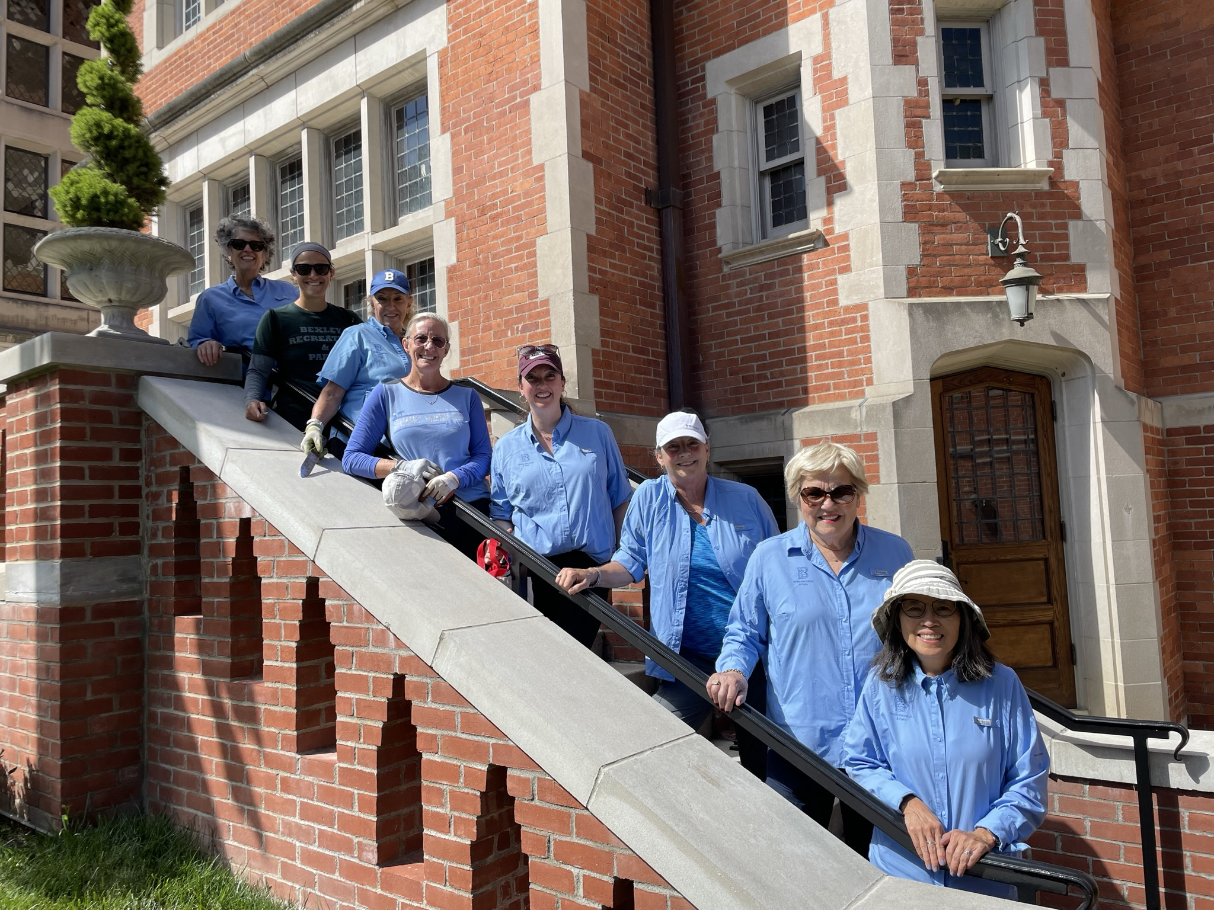
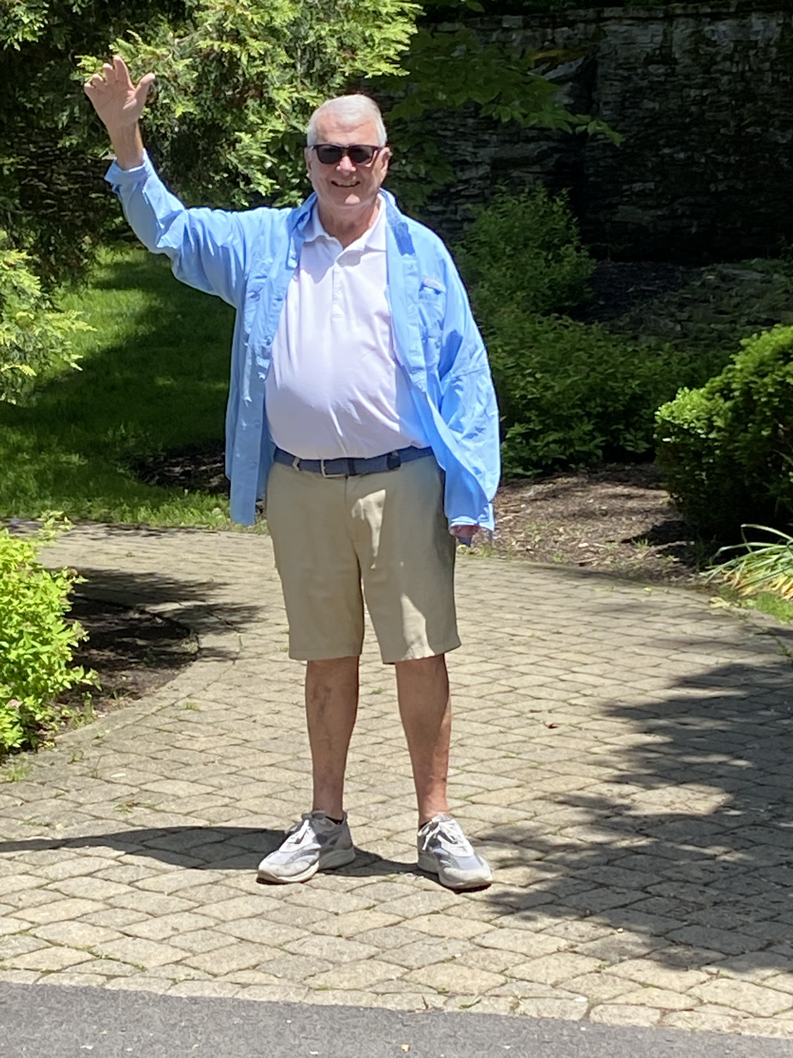
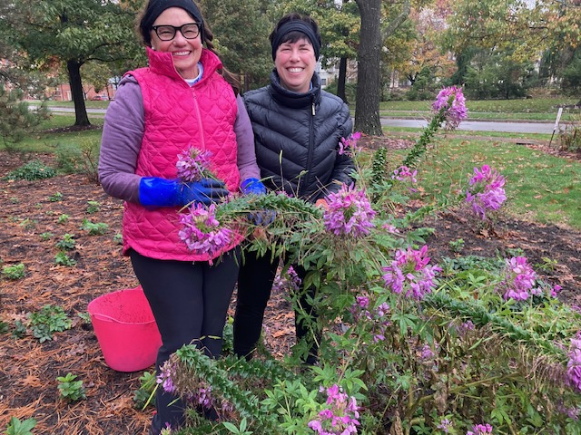
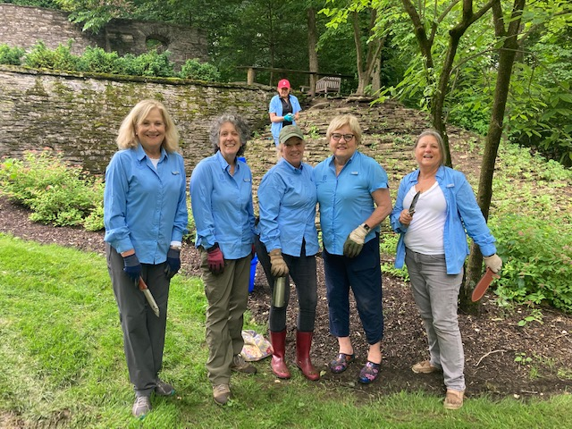
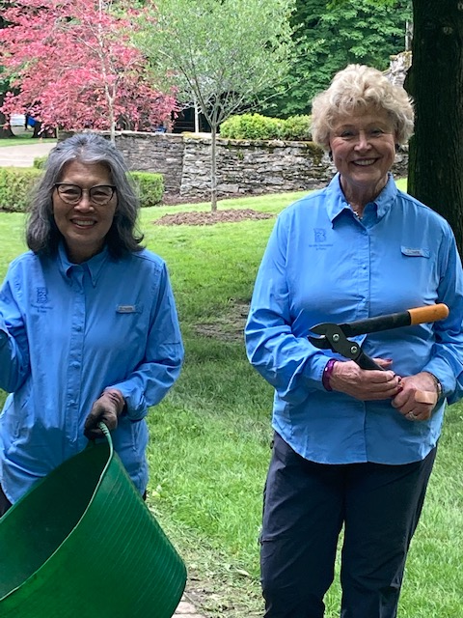
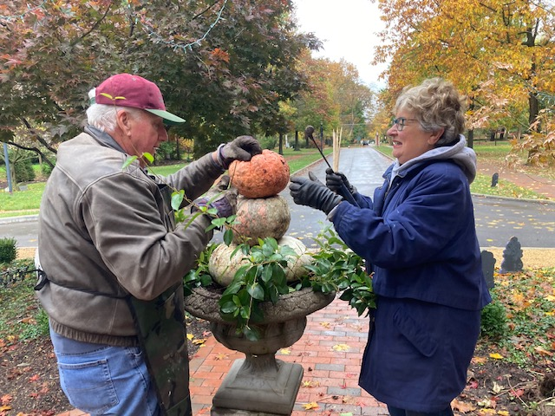
Bexley Bloomers

Slide 4
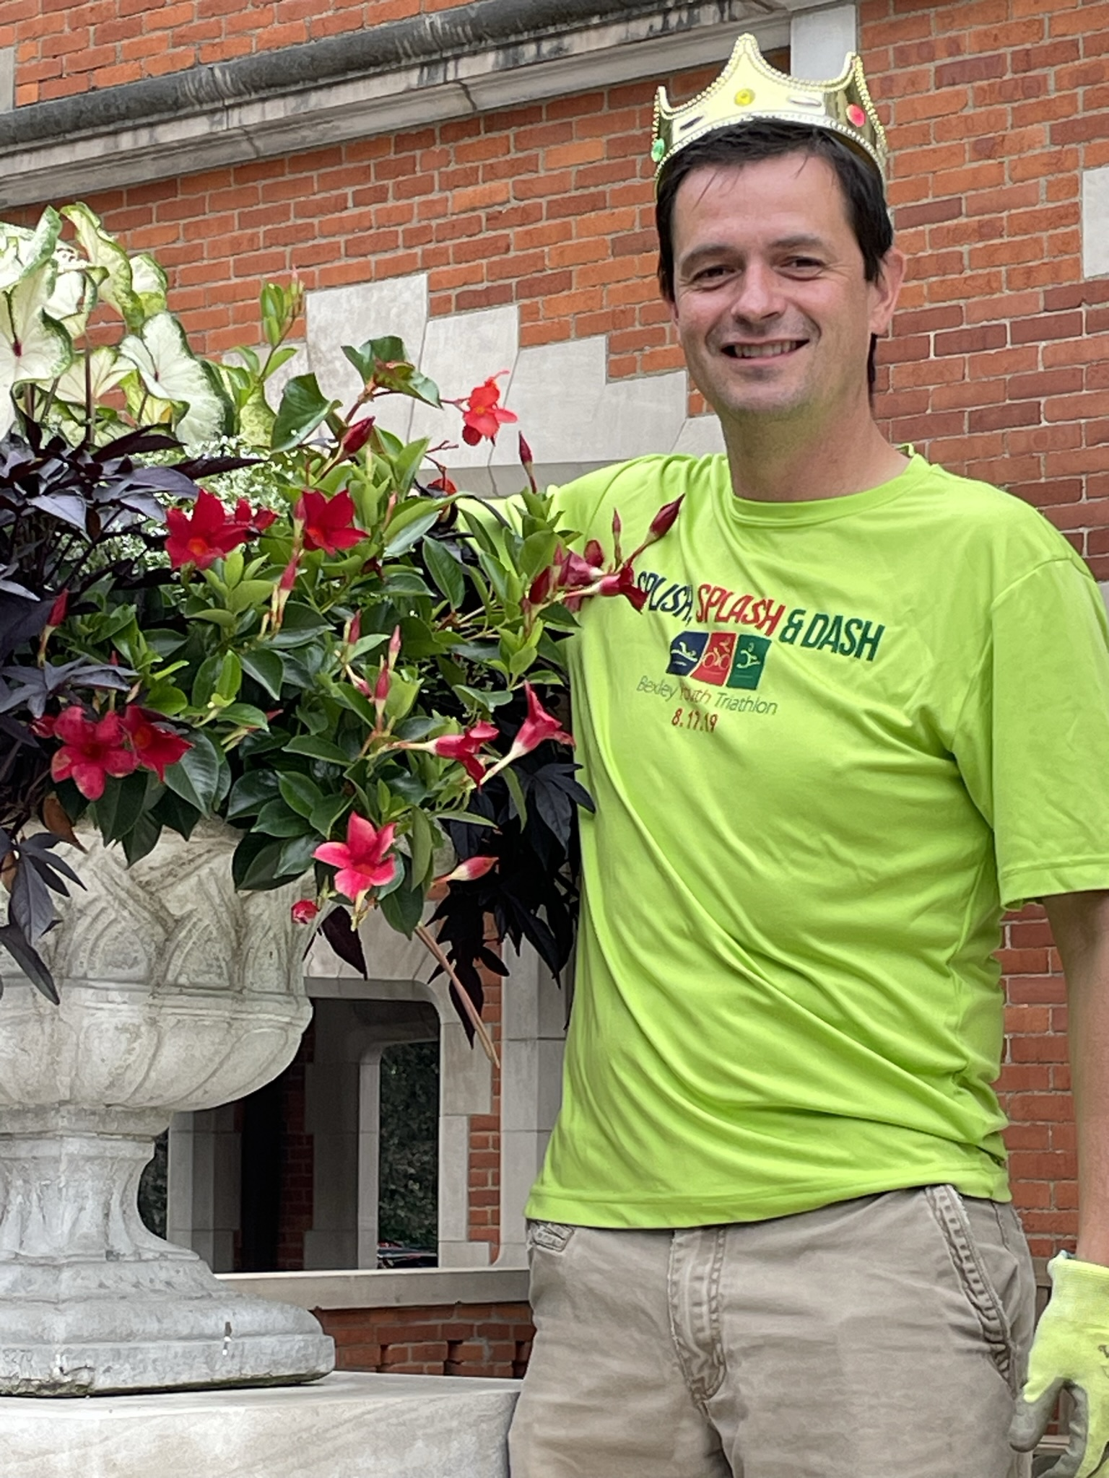
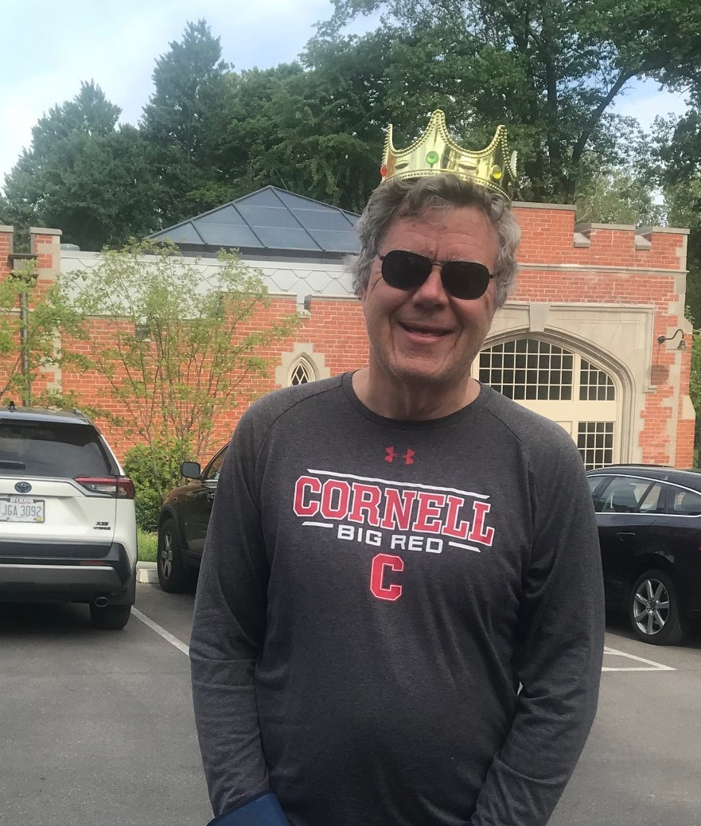
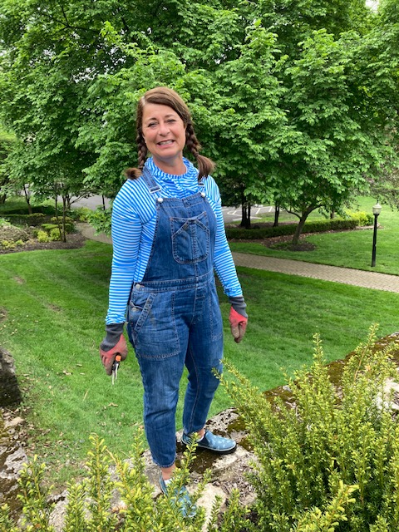
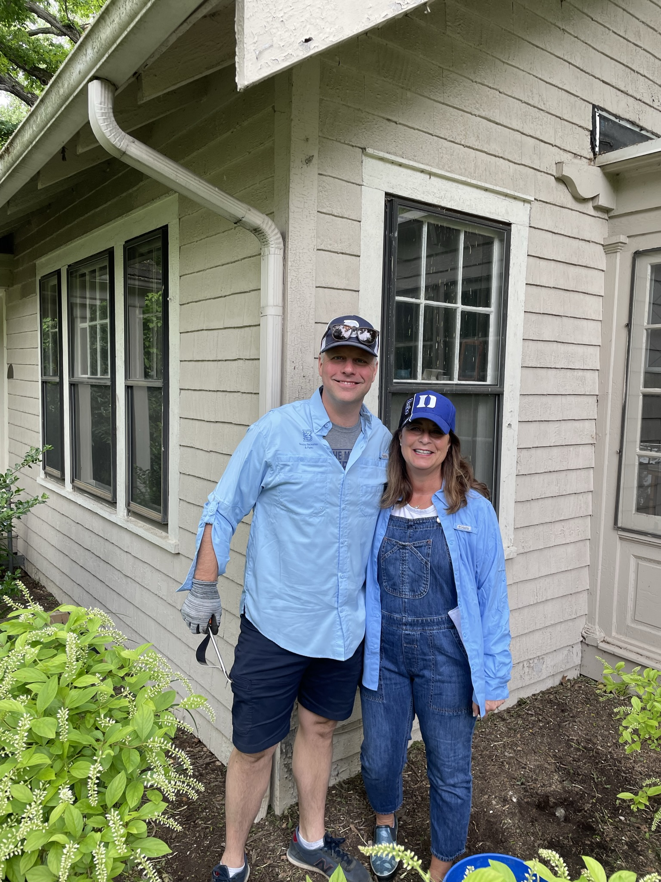
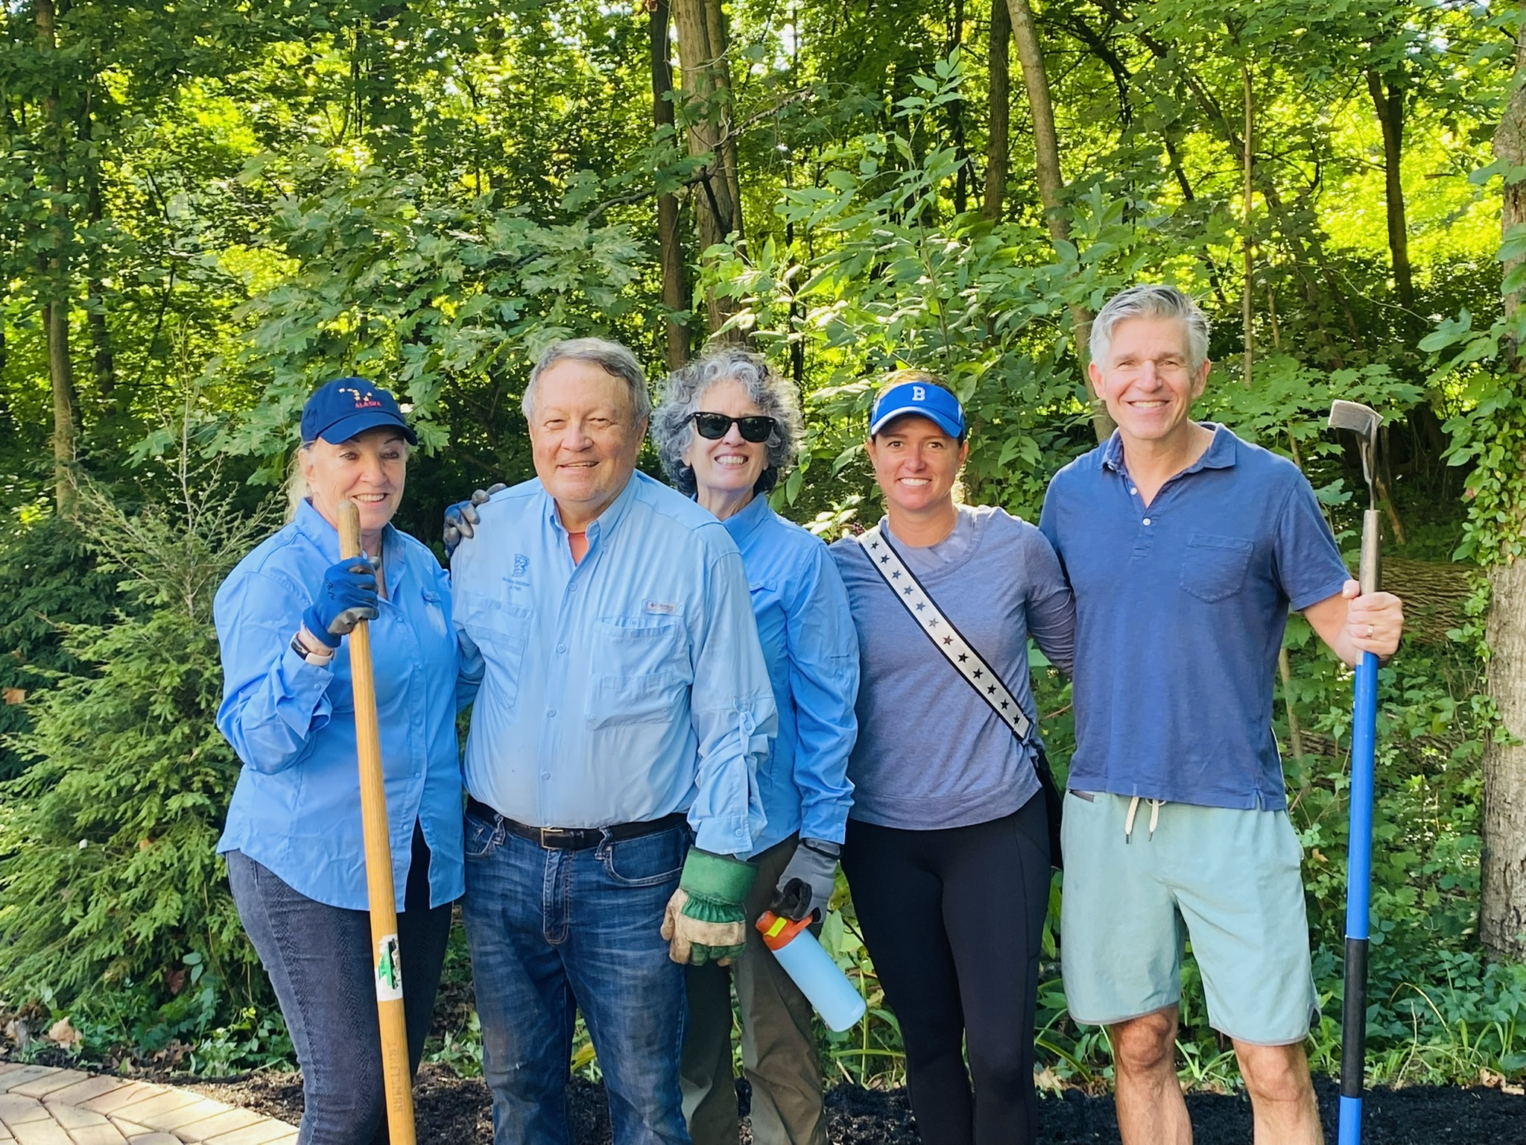
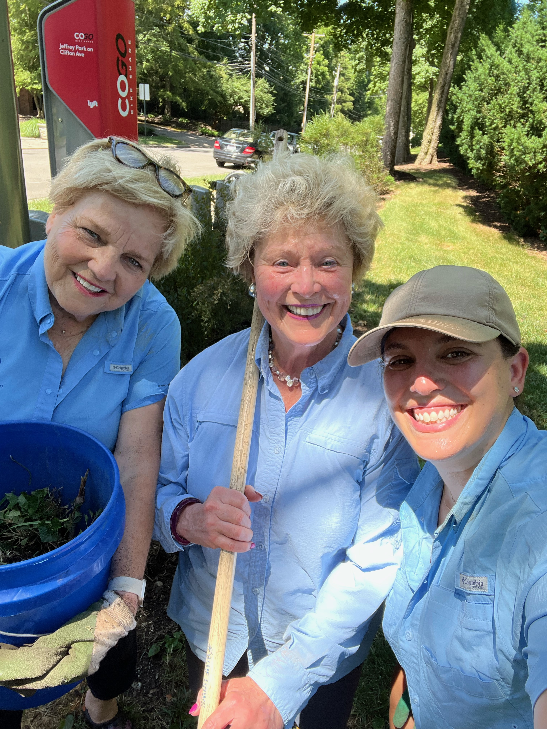
Bexley Bloomers – Celebrity Edition

Slide 5
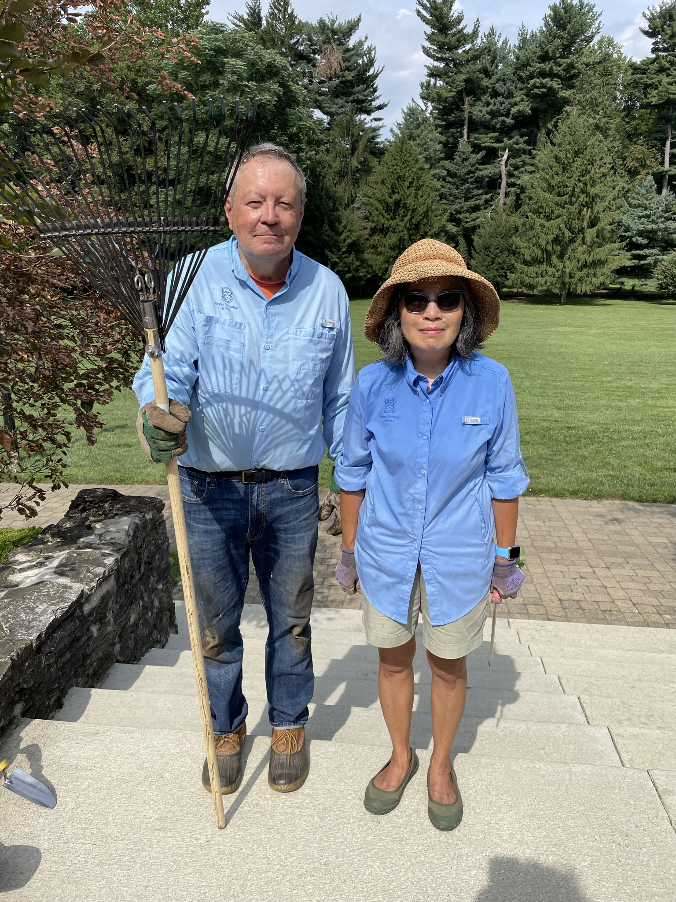
Bexley Bloomers
How can you help?
VOLUNTEER and bring a friend!
Thursday mornings
9:00 a.m. start time (8:30 if it’s going to get warm)
Bring garden gloves, hand tools, and water
Stay an hour or three!
Great support from P&R Staff!

