Slide 1


2023 Property Reappraisal Overview

Slide 2
Why does the Franklin County Auditor’s office conduct reappraisals?
All county Auditors in Ohio are required by state law to update the value of all properties by conducting a reappraisal every six years (Ohio Revised Code section 5713.01), with a Triennial Update at the 3-year midpoint between reappraisals.
This is an effort to accurately reflect property value changes in the current real estate marketplace.
The Ohio Department of Taxation makes the final determination as to whether updated property values determined by the Auditor are accurate and acceptable.
County Auditors may face legal action if the Dept. of Taxation determines reappraisal values are inaccurate and not subsequently corrected.

Slide 3
What happens during this process?
Data is collected from multiple sources to establish updated property values, including:
Recent home sales in your neighborhood – this is one of the most significant factors.
Neighborhood data such as infrastructure quality and proximity to community amenities and resources is another important measure used by appraisers in determining home value.
A visual exterior inspection of the condition of your property relative to other properties in the neighborhood is conducted to determine physical characteristics such as age, condition, and recent home improvements which will also affect appraised value.
All data collected is then aggregated to re-establish baseline Auditor property valuations and ensure each property value countywide aligns with the current housing market.

Slide 4

Visit the Know Your Home Value Website
More information about the Franklin County 2023 Property Reappraisal can always be found at www.franklincountyauditor.com/knowyourhomevalue. ​

Slide 5
What can I expect, and when?
August 2023:
Property owners notified by FCAO online and via mail about new tentative property valuation
August 2023:
Property owners who disagree with their tentative value may schedule time to speak virtually or
in-person with a member of the FCAO appraisal team at a property value review session to educate the Auditor’s office about what they feel their value should be
September 2023:
Individually scheduled 20-minute property value review sessions are held virtually and at physical locations throughout Franklin County
October 2023:
Final property value determinations are set by FCAO after tentative value property review meetings
December 2023:
Property owners who participated in a tentative value property review session are notified by mail of final property values for 2024 tax purposes

Slide 6
How will my property value be affected?
Most Franklin County property owners will see a property value increase.
This is due to a “perfect storm” of factors driving up fair market property values countywide.
Factors include:
  Continuing hot demand for property in Franklin County/Competitive real estate market
  Local population growth
  Lack of sufficient housing stock to meet demand
  Outside investment in local property market
  Cuts to local government/Outdated state laws
  Timing of statutorily-required sexennial property reappraisal
All these factors are combining to increase the amount being paid in recent arms-length real estate transactions – recent arms-length sales are one of the most significant factors driving appraised value.
While total number of sales in 2022 decreased when compared to 2021, property values in Franklin County have continued to increase over 33 of the past 36 months (as of 1/1/23).

Slide 7
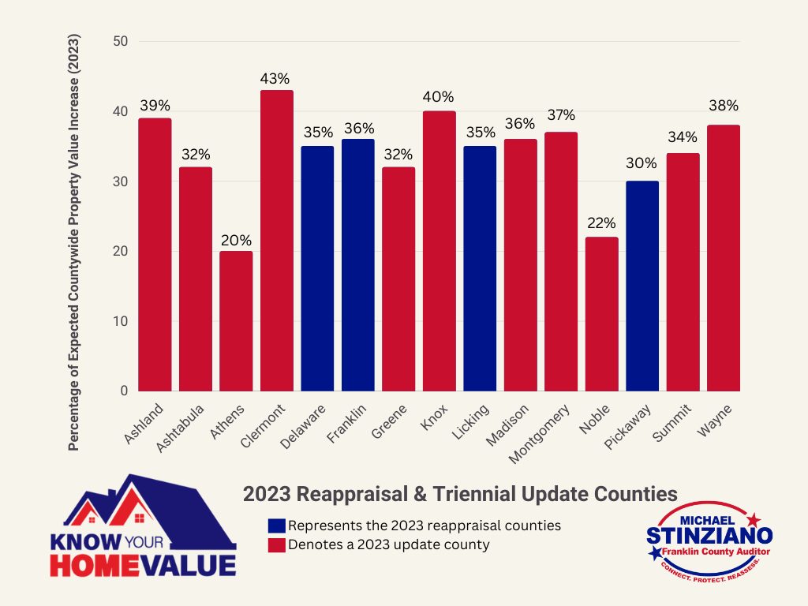
Are other Ohio counties expecting value increases in 2023?

Slide 8
Will the reappraisal affect my taxes?
Likely. This process is not intended to increase or decrease taxes – however, it may affect property taxes.
The Franklin County Auditor’s office is required by Ohio law to carry out the reappraisal and aims to complete the most accurate and fair property assessment possible.
It is important to remember that taxes are established at the ballot box through your taxing district and are based on voter approval.
  Property tax calculation: *35% of Auditor Property Value X Taxing District Rate = Total Property Tax
    *Note: Ohio law requires property owners to only pay taxes on 35% of a property’s full Auditor-appraised value. This is known as the “assessed” value.
The amount your taxes change is based on the value change of your property in relation to other properties in your taxing district.
There is not a 1:1 ratio between property value change and tax change – A 20% increase in value does not necessarily correlate to a 20% increase in taxes, for example.

Slide 9
Will the reappraisal affect my taxes?
If this… | Then this…
Your value increases at the same rate as the average increase in your taxing district | Minimal increase in taxes
Your value change decreases more than the average in your taxing district | Small decrease in taxes
Your value decreases, but the average in your taxing district increases | Moderate decrease in taxes
Your value increases, but less than the average in your taxing district | Small increase in taxes
Your value increases more than average increases in your taxing district | Moderate increase in taxes

Slide 10
Where does the additional tax money go?
Most property value increases don’t result in much higher overall taxes collected by political subdivisions
When values go up, tax rates generally go down to maintain the same taxes collected
  This is due to tax equalization, as laid out in Ohio House Bill 920
After the Franklin County 2020 Triennial Update:
  Property values: ↑ 20%
  Property taxes (All taxing authorities): ↑ 6.96%
    *Received by County, schools, cities, townships, villages, etc. altogether*
  Property taxes (Franklin County only): ↑ 2.57%
    *Received by County not including schools, cities, townships, villages, etc.*

Slide 11
Where does the additional tax money go?
Any additional taxes that are collected after a change in property values go toward the same things taxing entities would normally spend tax money on
Each taxing entity makes their own decisions on how to spend additional revenue
Examples:
  Covering increased cost of staffing and materials
  Physical infrastructure/buildings
  Increasing services
  Reducing/avoiding increasing any fees for services
  Changing what voted levies a subdivision may need to seek in the future

Slide 12
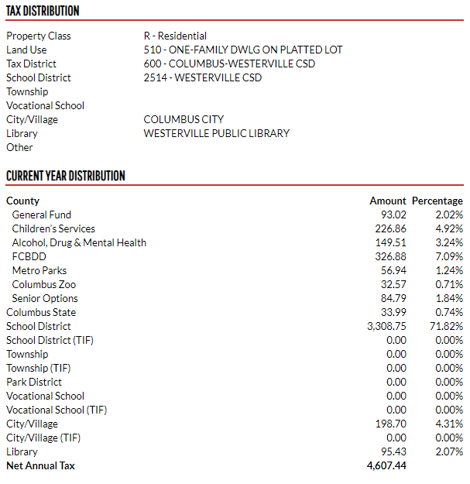
Where does the additional tax money go?
You can contact your local elected officials including school boards, county commissioners, city councils, and township trustees for more information on how they spend their budget.
You can also visit the Franklin County Auditor’s office property search page to search for your property and find a breakdown of where your tax money goes
  Navigate to www.franklincountyauditor.com and look for “Property Search” under the Real Estate tab

Slide 13
How can I help ensure accurate valuations?
1. Check your property’s data for accuracy by visiting the Franklin County Auditor’s office property search page, available under the “Real Estate” tab at www.franklincountyauditor.com, and notify the office if you spot any errors.
2. If you feel your tentative value is inaccurate upon receipt in August 2023, participate in a property value review session in September 2023 to educate our team about what you feel the true value of your property is.

Slide 14
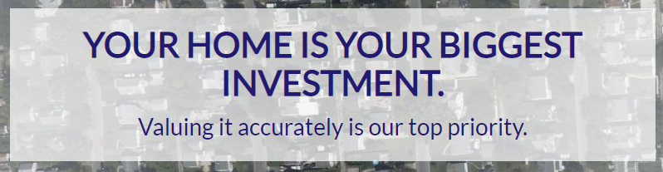
Where can I find additional information?
Additional information about the Franklin County 2023 Property Reappraisal can always be found at www.franklincountyauditor.com/knowyourhomevalue.
In addition to information about the reappraisal, a variety of tools will be added to the site throughout 2023 to assist property owners with navigating the reappraisal process, including:
  Interactive “Compare My Home Value” GIS Mapping/Neighborhood Data tool (available August 2023)
  2024 Property Tax Estimator tool (available August 2023)
  Tentative Value Property Review scheduling portal (available August 2023)

Slide 15
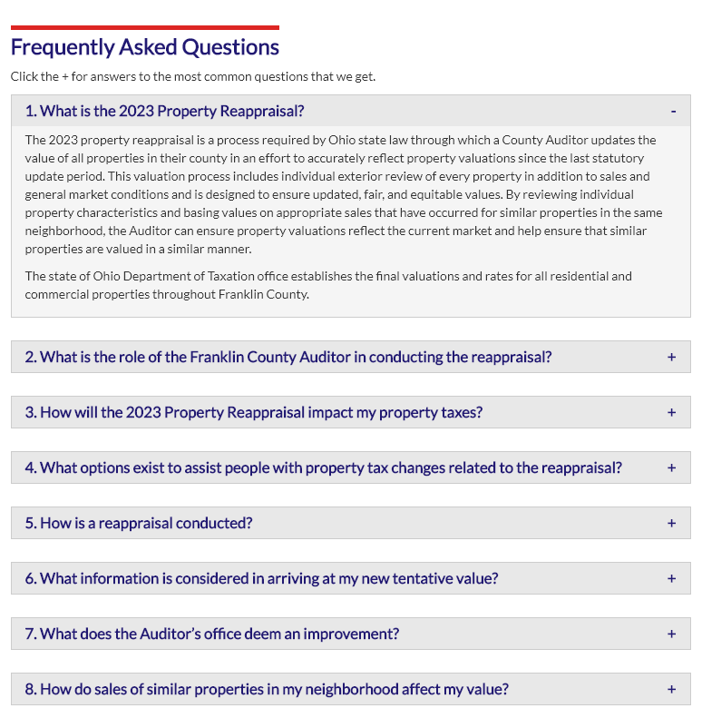
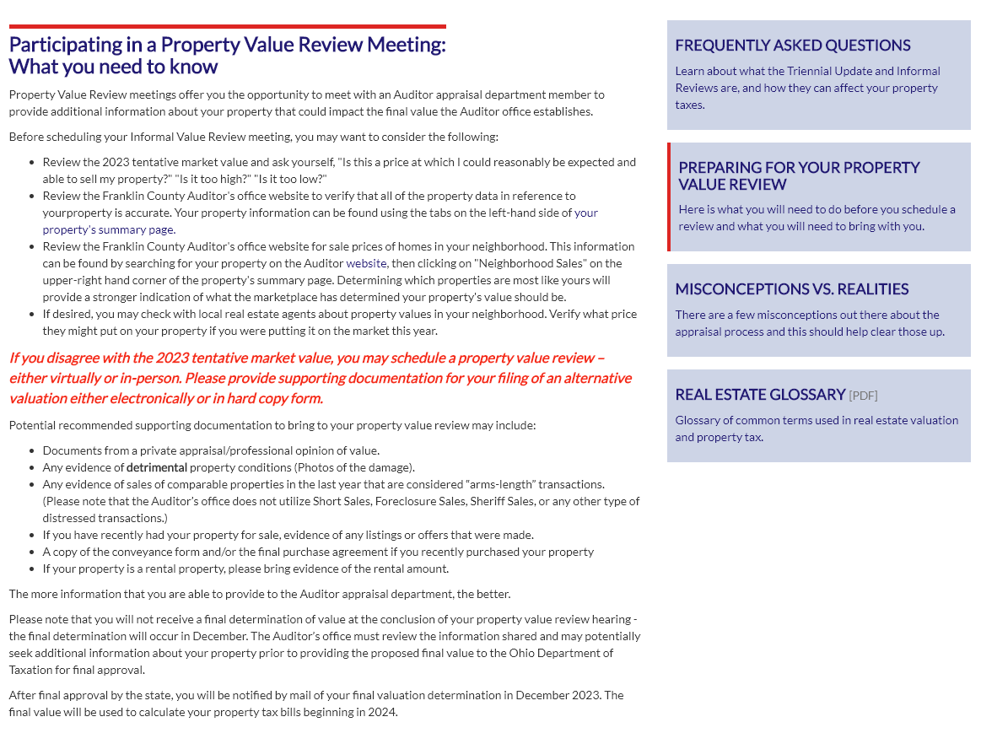
What else can I find on the Know Your Home Value website?

Slide 16
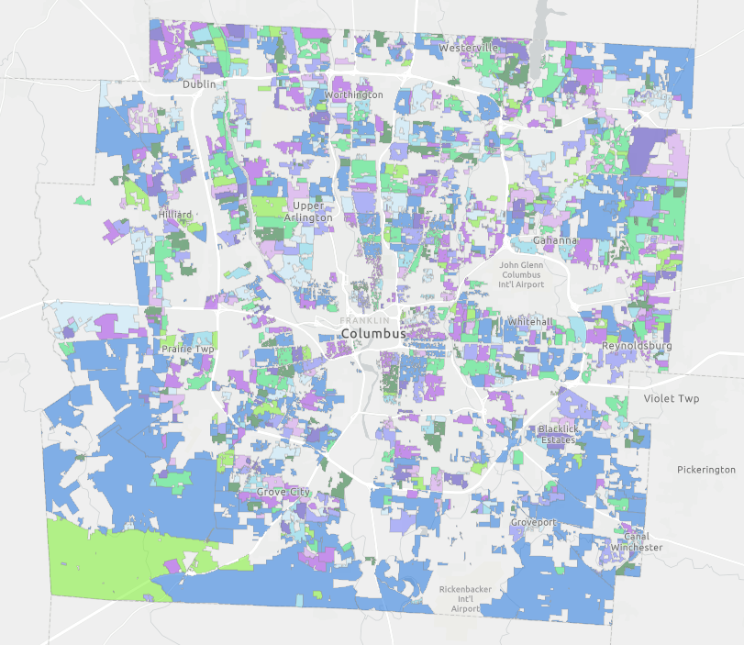
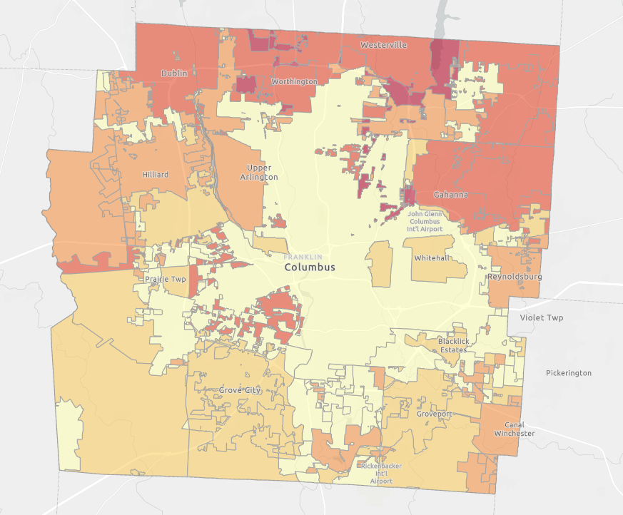
Know Your Home Value Website
2023 Updated Neighborhood Delineations
2022 Effective Residential Tax Rates

Slide 17

What else can I find on the Know Your Home Value website?

Slide 18

What else can I find on the Know Your Home Value website?

Slide 19
Confused? Concerned?
Here’s who to contact:
Franklin County residents are encouraged to contact the Auditor’s office at any time with questions about the reappraisal, property taxes, or any other issues with which Michael or a member of the office may be of assistance, either by email at AuditorStinziano@franklincountyohio.gov or phone at 614-525-HOME (4663).
Additionally, property owners concerned about a post-reappraisal change in taxes can find more information and resources regarding programs designed to assist with property taxes below:
Franklin County Property Tax Assistance Program
Franklin County Auditor Tax Reduction programs
Franklin County Treasurer STAR Program

Slide 20
Thank you!

