Slide 1


Rob Crane, MD
Amanda Turner
Preventing Tobacco Addiction Foundation

Slide 2


Slide 3
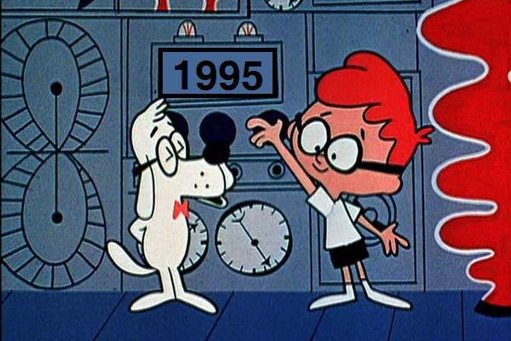
1775
Washington Crosses the Delaware

Slide 4
2004
Smokefree Columbus

Slide 5
2016
Tobacco 21

Slide 6
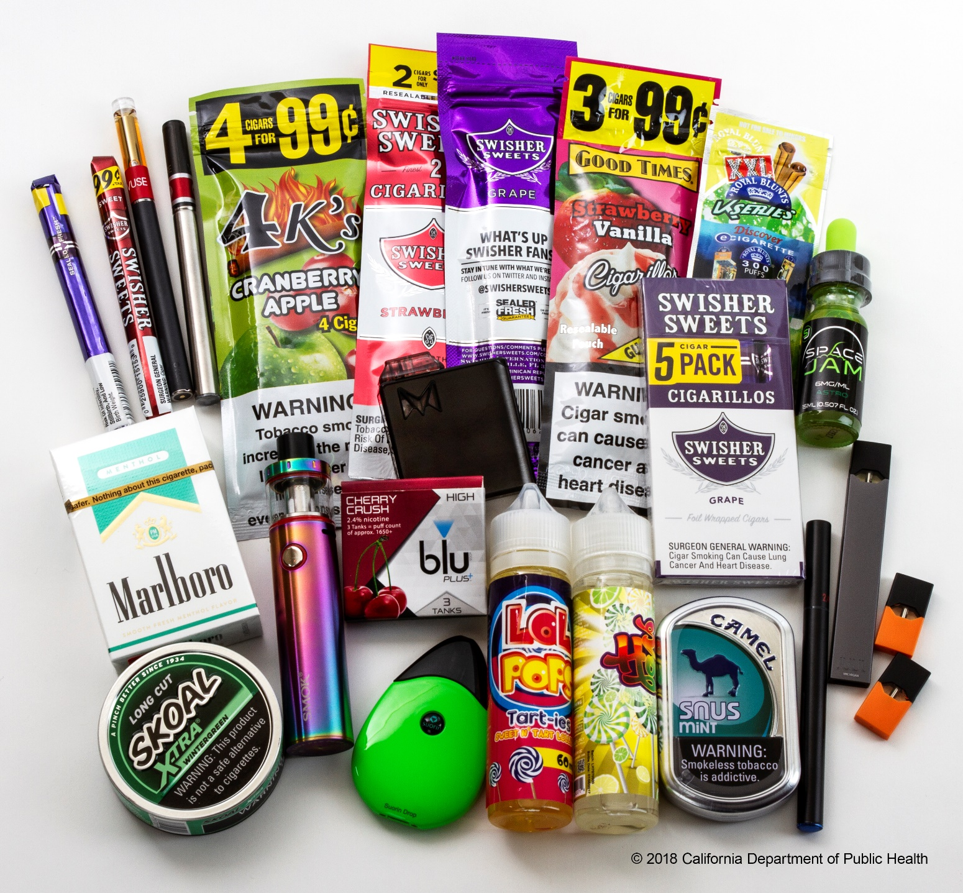
Flavored Tobacco Products Are Putting
a New Generation of Kids at Risk

Slide 7
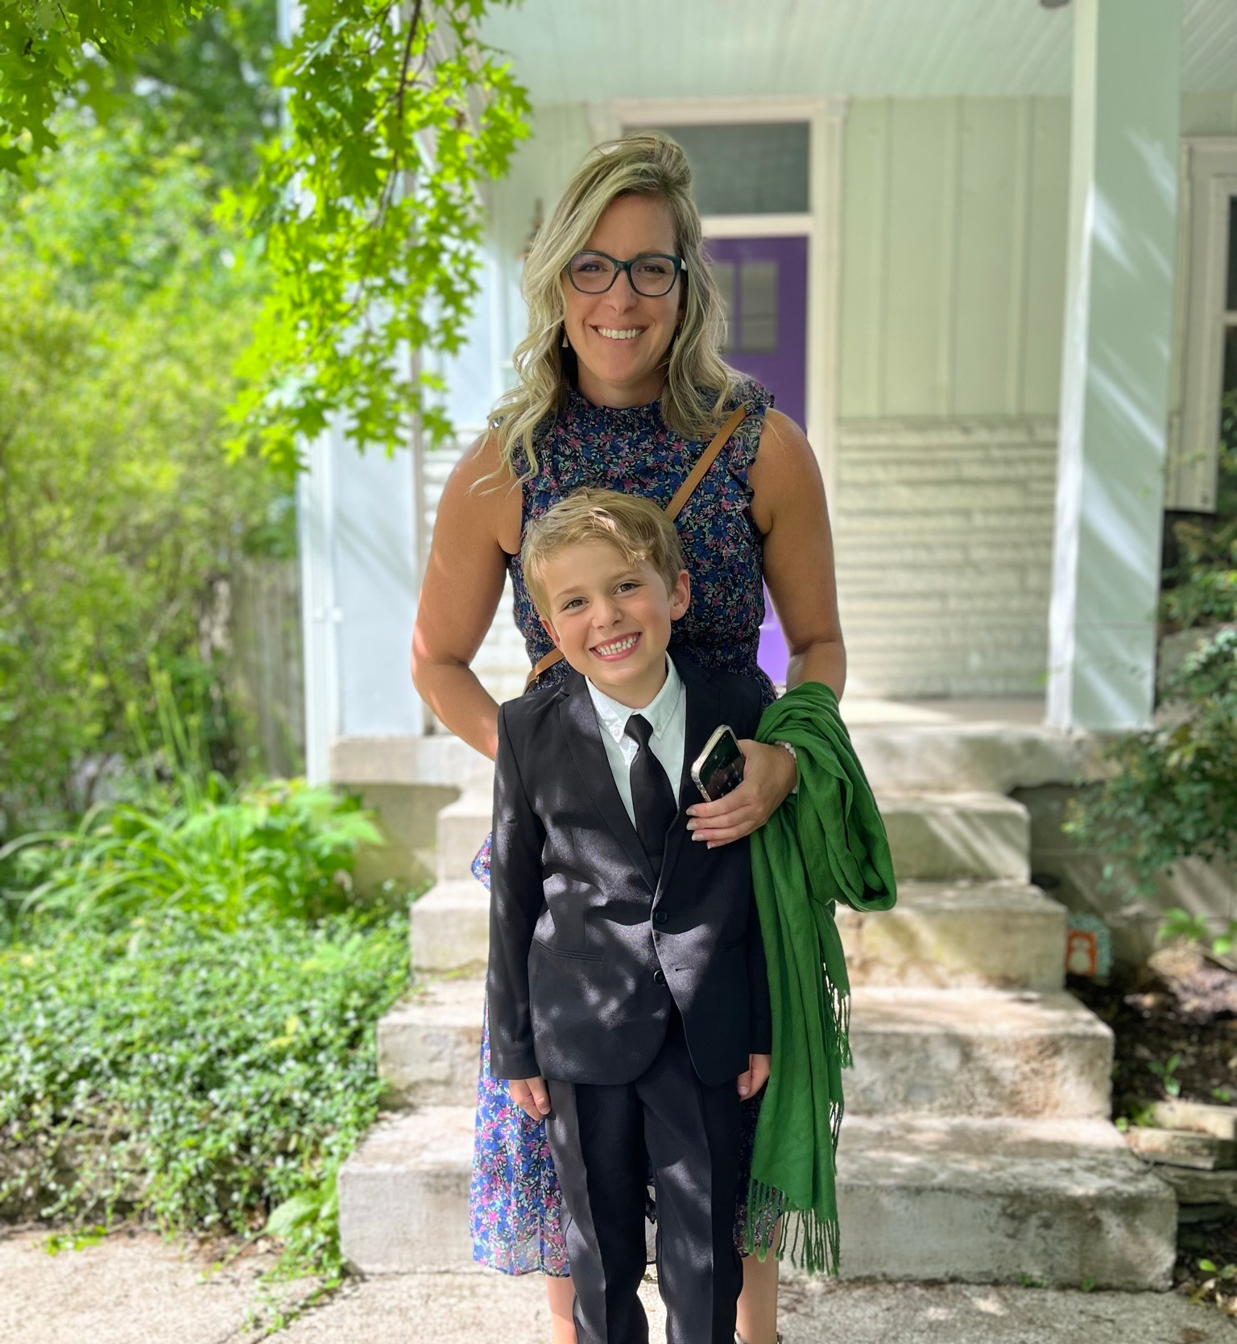

Notes:
Executive Director…but more importantly a mom to my son George
I’m also the daughter of a tobacco farmer from South Carolina who died when I was 10 years old from lung cancer
I’ve strongly disliked tobacco but today I fear it because this is the most innovative industries

Slide 8
The Tobacco Industry Has Known for Decades that Flavors Attract Kids
“It’s a well-known fact that teenagers like sweet products. Honey might be considered.”
-Memo to Brown & Williamson, 1972
“Make a cigarette which is obviously youth oriented. This could involve cigarette name, blend, flavor and marketing technique....for example, a flavor which would be candy-like but give the satisfaction of a cigarette”
-R.J. Reynolds Memo, 1974
“Cherry Skoal is for somebody who likes the taste of candy, if you know what I’m saying.”
-U.S. Smokeless Tobacco Sales Representative, 1994

Slide 9


In Ohio…
Nearly 30% of high school students and 12% of middle schoolers smoke e-cigarettes.
Ohio ranks 5th in the nation for tobacco use.
The State of Ohio has failed
to properly enforce the law
against selling tobacco to
kids under 21.

Slide 10
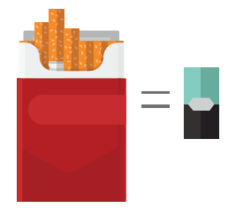
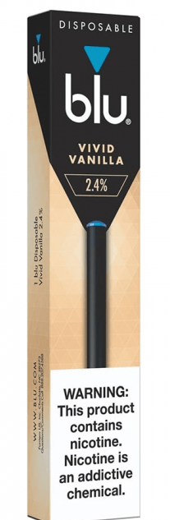


Flavored Tobacco Products Are Popular Among Kids
81% of kids who have ever used a tobacco product started with a flavored tobacco product
72% of current kid tobacco users used a flavored tobacco product in the past month
7 out of 10 of current kid e-cigarette users say they use e-cigarettes “because they come in flavors I like”
A single Juul pod or disposable device contains as much nicotine as a pack of cigarettes…most contain 25-50 cigarettes worth of nicotine
Source: Ambrose et al., JAMA, 2015
Rose et al., Tobacco Control, 2019
  2021 NYTS & 2016-2017 PATH
  Image source: CDC, https://www.cdc.gov/tobacco/basic_information/e-cigarettes/factsheet/index.html
Notes:
This growing market is no coincidence: the tobacco industry knows that flavored tobacco products appeal primarily to youth and new smokers. 7 out of 10 kids current kid e-cigarette users say they use ”because they come in flavors they like”
A single Juul pod contains as much nicotine as a pack of 20 cigarettes. Many other brands contain equivalent or even higher nicotine levels.
Our children are being exposed to huge amounts of nicotine. This is deeply concerning.
Kids, parents, teachers and pediatricians across the country are sharing devastating stories of addiction and withdrawal. Some kids wake up in the night to vape or can’t make it through a class period without leaving to vape.
According to the Surgeon General, “Youth use of products containing nicotine in any form, including e-cigarettes, is unsafe, can cause addiction and can harm the developing adolescent brain.”
According to the Surgeon General, nicotine can prime the brain for addiction to other drugs.
If that isn’t bad enough, young people who use e-cigarettes may be more likely to go on to use regular cigarettes.

Slide 11
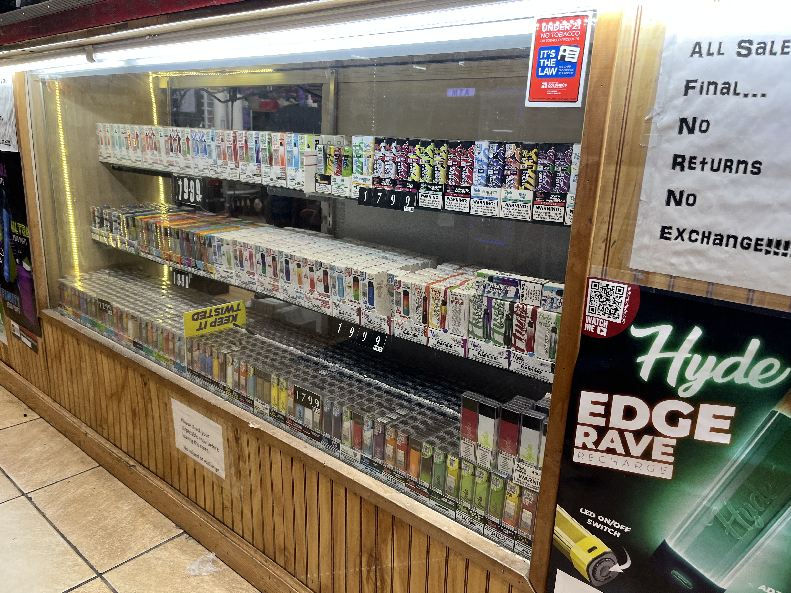
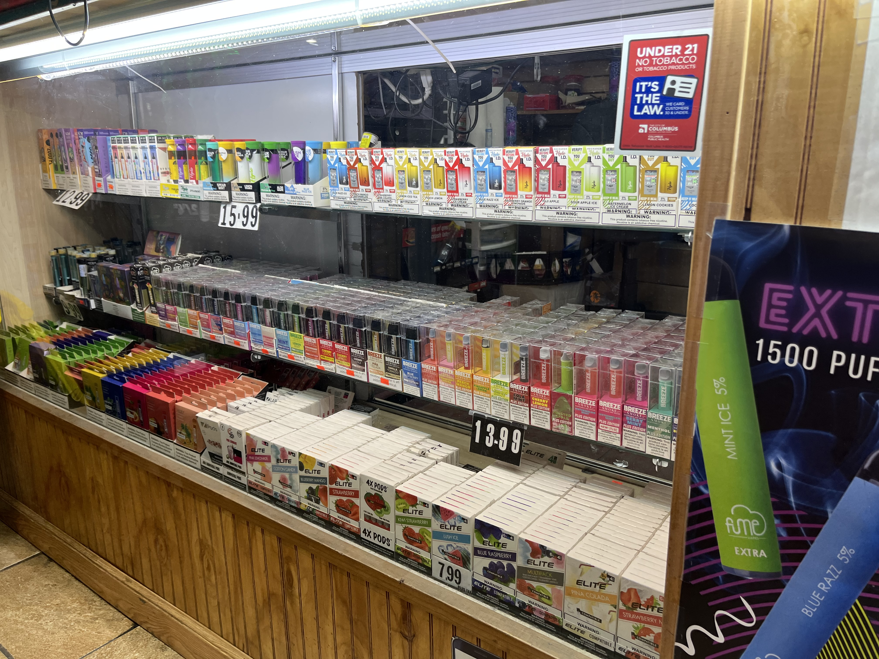
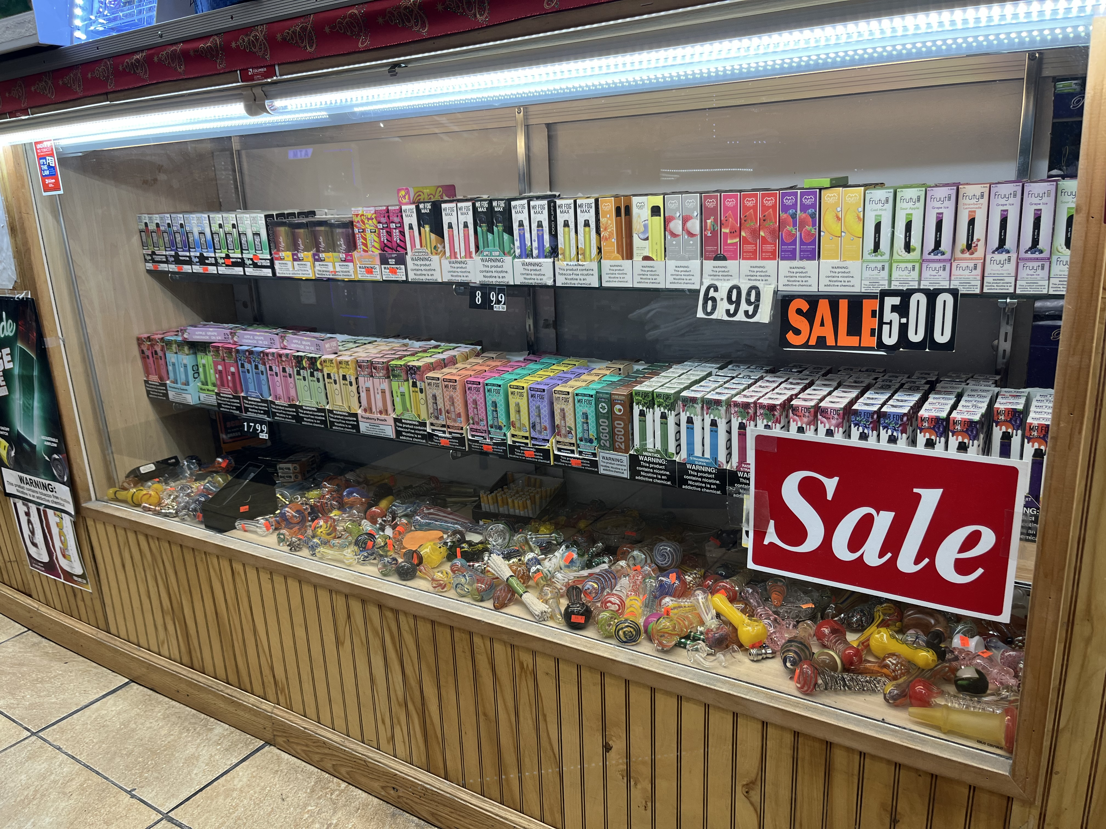
An Explosion of Flavored Tobacco Products
More than 15,500 unique e-cigarette flavors available online
More than 250 unique cigar flavors available
While overall cigarette sales have been declining…
…the proportion of smokers using menthol cigarettes has been increasing: menthol products made up 37% of the cigarette market share in 2019
Sources: Zhu, S-H, et al.; 2018; Delnevo, CD, et al.; 2017; Villanti, A, et al., 2016.; FTC, 2019 Cigarette Report
Notes:
Despite the FDA’s ban on flavored cigarettes, the overall market for flavored tobacco products has grown.
Continuing a long tradition of designing products that appeal explicitly to new users, tobacco companies in recent years have significantly stepped up the introduction and marketing of flavored other tobacco products (OTPs), particularly e-cigarettes and cigars,

Slide 12


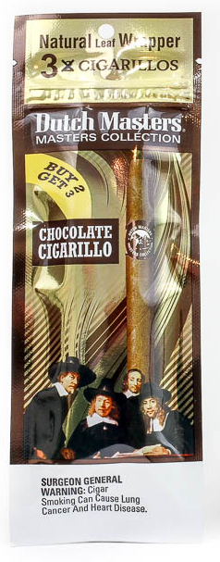
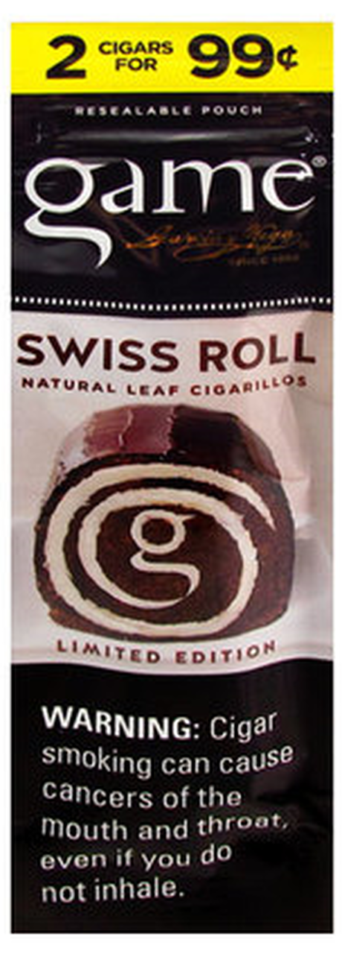

250 Cigar Flavors and Counting…

Slide 13

Flavors set
the hook… nicotine reels them in!

Slide 14


Slide 15
An impressive reduction over 20 years as we've used all our tools to help persuade kids to refuse tobacco
Notes:
For me at least, that question is answered. The e-cigarette "epidemic" threatens to erase decades of progress with adolescents' use. E-cig proponents answer, well cigarette smoking hasn't gone up with the advent of e-cigs. That statement of course is not true in Ireland where teen smoking is up 15%, but even in the US, look more closely at the graph. Click. Does that help. This is where we should be.

Slide 16
20 years of progress against adolescent nicotine addiction virtually wiped out by e-cigarette promotion

Slide 17
The Proposal Being Considered by Columbus
Retailers would not be allowed to sell flavored nicotine or tobacco products including menthol cigarettes and flavored e-cigarettes (vapes)
Individual possession, use or purchase would not be illegal
Enforcement only at the retail level by the Health Department using civil procedure, no use of police.
The Cities of Columbus, Dublin and Worthington have a Tobacco Retail License (TRL) in place to assist in monitoring and enforcement.
Over 300 Cities and 5 States have already acted.

Slide 18
Action for Children
ADAMH Board of Franklin County
Aids Healthcare Foundation
American Cancer Society Cancer Action Network
American Heart Association
American Lung Association
Arthur G. James Cancer Hospital & Richard J. Solove Research Institute
Black Girl Rising
Black Physician's Network
Campaign for Tobacco Free Kids
Cancer Support Community
Central Community House
Charitable Pharmacy of Central Ohio
Children’s Defense Fund-Ohio
Columbus Medical Association
Columbus Public Health
Columbus Urban League
Community for New Direction
Franklin County Public Health
Gamma Alpha
Help & Hope Community Center
Human Services Chamber
Impact Community Action
Kaleidoscope Youth Center
Maryhaven
Mid-Ohio Food Collective
Mt. Carmel Health System
NAACP Columbus Chapter
Nationwide Children's Hospital
Ohio Academy of Family Physicians
Ohio Chapter, American Academy of Pediatrics
OhioHealth
Parents Against Vaping E-cigarettes
Pelotonia
PFLAG Columbus (OH)
PrimaryOne Health
Preventing Tobacco Addiction Foundation/Tobacco 21
St. Vincent Family Services
Stonewall Columbus
Syntero, Inc.
The Breathing Association
The Center for Community Solutions
The Center for Healthy Families
The Columbus African American News Journal
The Ohio State University College of Social Work
The Ohio State University Wexner Medical Center
United Way of Central Ohio
SUPPORT
LOCAL
Plus 83 Faith Based Organizations

Slide 19
Academy of General Dentistry
Action on Smoking and Health
African American Tobacco Control Leadership Council
Allergy & Asthma Network
American Academy of Family Physicians
American Academy of Oral and Maxillofacial Pathology
American Academy of Oral and Maxillofacial Radiology
American Academy of Otolaryngology - Head and Neck Surgery
American Academy of Pediatrics
American Association for Cancer Research
American Association for Dental, Oral, and Craniofacial Research
American Association for Respiratory Care
American Cancer Society Cancer Action Network
American College Health Association
American College of Cardiology
American College of Chest Physicians (CHEST)
American College of Physicians
American Dental Association
American Dental Education Association
American Heart Association
American Lung Association
American Medical Student Association
American Psychiatric Association
American Public Health Association
American Society of Addiction Medicine
American Thoracic Society
Americans for Nonsmokers’ Rights
Asian Pacific Partners for Empowerment, Advocacy and
Leadership (APPEAL)
Association for Clinical Oncology
Association for the Treatment of Tobacco Use and
Dependence
Association of Black Cardiologists
Association of Schools and Programs of Public Health
Association of State and Territorial Health Officials
Asthma and Allergy Foundation of America
Big Cities Health Coalition
Black Ladies in Public Health
Black Women's Health Imperative
Campaign for Tobacco-Free Kids
Cancer Prevention and Treatment Fund
CATCH Global Foundation
Catholic Health Association of the United States
Commissioned Officers Association of the U.S. P.H.S.
Common Sense
Community Anti-Drug Coalitions of America (CADCA)
COPD Foundation
Emphysema Foundation of America
Eta Sigma Gamma, National Health Education Honorary
First Focus Campaign for Children
GLMA: Health Professionals Advancing LGBTQ Equality
GO2 Foundation for Lung Cancer
International Association for the Study of Lung Cancer
March of Dimes
NAACP
Mesothelioma Applied Research Foundation
National Association County and City Health Officials
National Association of Hispanic Nurses
National Association of Pediatric Nurse Practitioners
National Association of School Nurses
National Association of Secondary School Principals
National Association of Social Workers
National Black Nurses Association
National Caucus and Center on Black Aging, Inc.
National Consumers League
National Dental Association
National Education Association
National Hispanic Council on Aging
National Hispanic Medical Association
National LGBT Cancer Network
National Medical Association
National Network of Public Health Institutes
Oncology Nursing Society
Parents Against Vaping e-cigarettes (PAVe)
Prevent Cancer Foundation
Preventing Tobacco Addiction Foundation/Tobacco 21
Public Health Law Center
Public Health Solutions
Society for Cardiovascular Angiography & Interventions
Society for Public Health Education
Society for Research on Nicotine & Tobacco
Society of State Leaders of Health and Physical Education
Students Against Destructive Decisions (SADD)
The Center for Black Health and Equity
The Links, Inc
The Society of Thoracic Surgeons
Trinity Health
Truth Initiative
NATIONAL
SUPPORT

Slide 20


Slide 21

WHAT ARE WE ASKING OF YOU
Talk to your high-school and middle school principals.
Reach out to teachers, resource officers, substance abuse coalitions.
Ask parents – ask teens what their experience had been?
Think about what you can do to protect your kids from the number one cause of preventable death.

Slide 22
Rob Crane, MD. Rob.Crane@PTAF.org
Amanda Turner Amanda.Turner@PTAF.org
Preventing Tobacco Addiction Foundation

