Slide 1
The Shah Residence
424 South Columbia
The City of Bexley, Ohio
Board of Zoning and Planning
Request for Certificate of Appropriateness
March 24, 2021

Slide 2
January 28, 2021 BZAP Hearing
Testimony:
Lekha Shah - Homeowner
  Project history and acceptance of Staff’s conditions
Matt Sullivan - Sullivan Builders
  Efforts to remediate prior contractor’s mistakes
Brian Kent Jones - The Jones Studio
  Compatibility with the neighborhood

Slide 3
Modifications to Certificate of Appropriateness
Window grids
Height of home from 36’-6” to 38’-0”
Side entry
Skylight

Slide 4
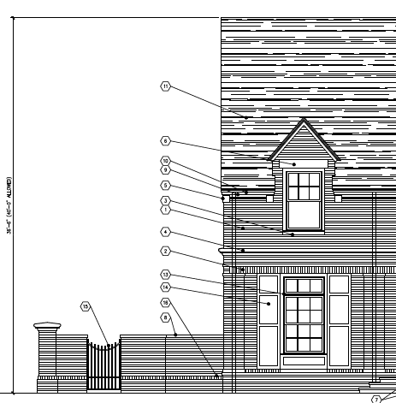
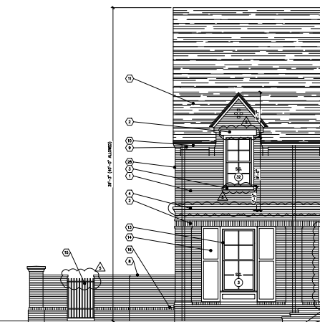
Height
2018 Design
36’-6”
As-Built
Surveyed at 38’-0”
*Code permits 40’-0”

Slide 5
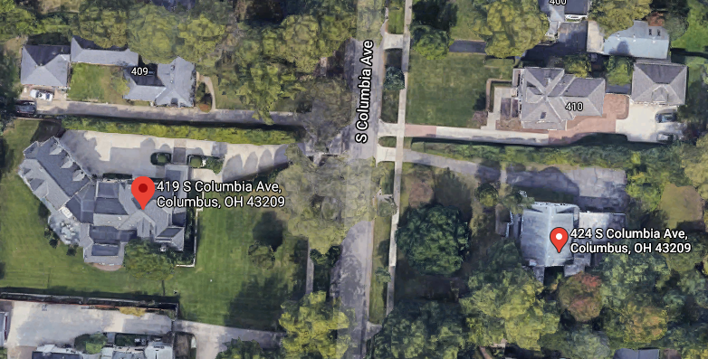
419 South Columbia
Surveyed: 39.74 feet tall

Slide 6
Mikel Coulter
Architect with CTL Engineering, Inc.
  Manager of the Building Envelope and Roof Engineering Services Department
Chairman of the Architectural Review Board and Municipal Planning Commission for the City of Worthington, Ohio
Member of the Board of Directors and Building Code Review Committee of the City of Worthington, Ohio
Member of the Board of Zoning Appeals of the City of Worthington, Ohio

Slide 7
Issues with Prior Contractor
To briefly address the Board’s questions during the January 28, 2021 meeting:
Jen Salamon
Lekha Shah

Slide 8
Support from Adjacent Neighbors
Charlie and Andrea Hire (436 S. Columbia)
Devorah Weprin (431 S. Drexel)
Shelby and Jill Furman (410 S. Columbia)

Slide 9
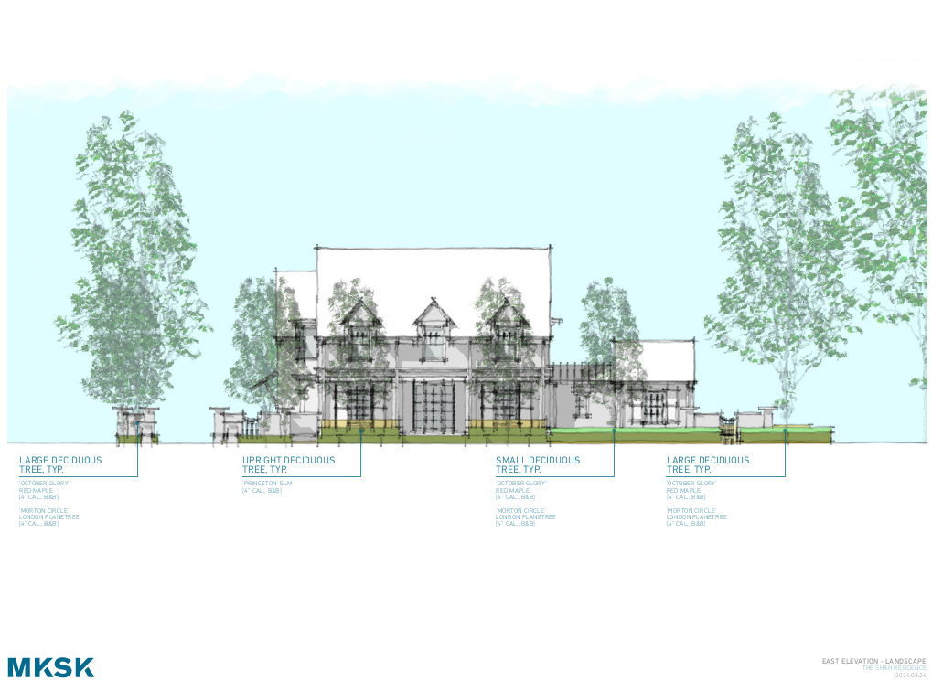
Landscaping

